Slide 1

Iowa Area Development Group
Community Foundation
Mission:
To foster economic development and community betterment by providing research and promotion, education and training, and community-based and guided philanthropy.

Slide 2
Grants Categories
Education and Training
  Leadership development programs and seminars in order to educate electric cooperative members, community volunteers and professional developers about tools, resources, and technical assistance in order to further local economic development efforts.
Research, Study and Analysis
  To undertake and/or support research, study, and analysis of the economy or segments of the economy of the State of Iowa in order to further local economic development efforts.
Project Support
  Provide grants and low interest loans in order to create jobs and promote community prosperity.
Administration and Technical Assistance
  To provide community based organizations throughout Iowa support for local philanthropic efforts.

Slide 4


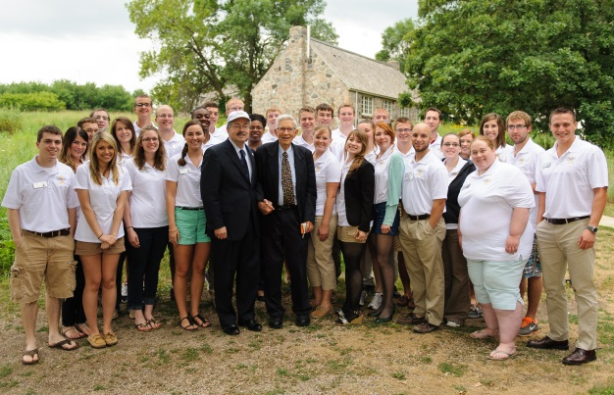





Organizations Supported with IADGCF Grants
Okoboji Entrepreneurship Institute
Entre Fest

Slide 5
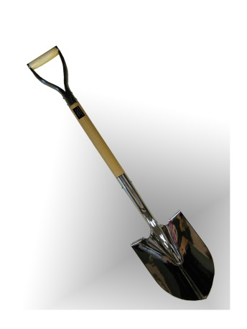
Silver Shovel Award
To celebrate IADG’s 25th Anniversary, the Silver Shovel Award honors the significant accomplishments of our rural development partners for their leadership, project development, community philanthropy, and successful program innovation. The IADG Community Foundation awarded $1,000 to 25 organizations.

Slide 6
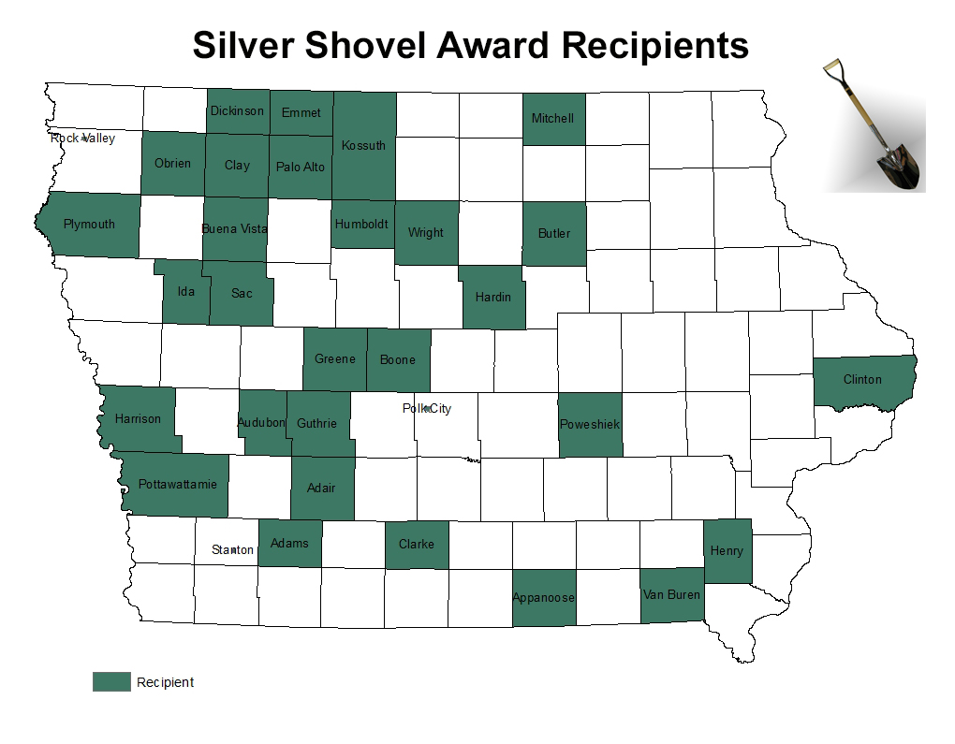

Slide 7
Gifts of Memory
Ben Adams
Kay Anderson
Edwin Armstead
Jack Bailey
Merrill Baker
Cecil Banks
Janet Collins
Eugene Drager
Bill and Jeanne Eddy
Marvin Focht
Holmes Foster
Bill Freeman
Joseph Freml
Don Glew
Brian Gongola
Robert Heirigs
Phyllis Hornocker
Larry Johnson
Eugene Kading
Paul Keller
Dwight Krebill
Mary Krug
Richard Mickelson
Gregg Miller
Gary Mount
Doris Newman
Marie Nicholas
Steve Piecara
Jack Prevo
Josef Rohner
Dorothy Toyne
Dawn Vance
Franklin Walter
Patricia Ward
Roger Wieck
John Wietzke
Richard Peterson
Keith Wirt
Lorraine Hansen
Wayne Hornocker
Calvin Hultman

Slide 8
Gifts of Honor
CIPCO Employees
Rand Fisher
Gilbert Phillips
Dennis Murdock

Slide 9
Thank You IADGCF Donors
Associated Electric Cooperative
Bank of America
Reggie and Mary Clause
Kay Cmelik
Central Iowa Power Cooperative
Community Vitality Center
Corn Belt Power Cooperative
Tim and Wendy DeVries
Jim Gossett
Humboldt/Dakota City
Iowa Area Development Group
Rand & Cyndi Fisher
Iowa Association of Electric Cooperatives
Robert Josten
Kossuth County Economic Development Corporation
Linn County REC
Jane Marden
Northeast Power Cooperative
Northwest Iowa Power Cooperative
Pella Rolscreen Foundation
Red Oak Industrial Foundation, Inc.
Norman and Mary Van Zante

Slide 10
Contact Us
Iowa Area Development Group Community Foundation
2600 Grand Avenue, Suite 430
Des Moines, IA 50312
Phone: 515-223-4817
Toll Free: 800-888-4743
Fax: 515-223-5719
E-mail: rfisher@iadg.com
www.IADG.com/foundation

